Slide 1

Team Name : Spectacular Crew
Team Leader Name : Sriram Karanam
Problem Statement : AI for Retail, Commerce & Marketplace Ecosystems

Slide 2
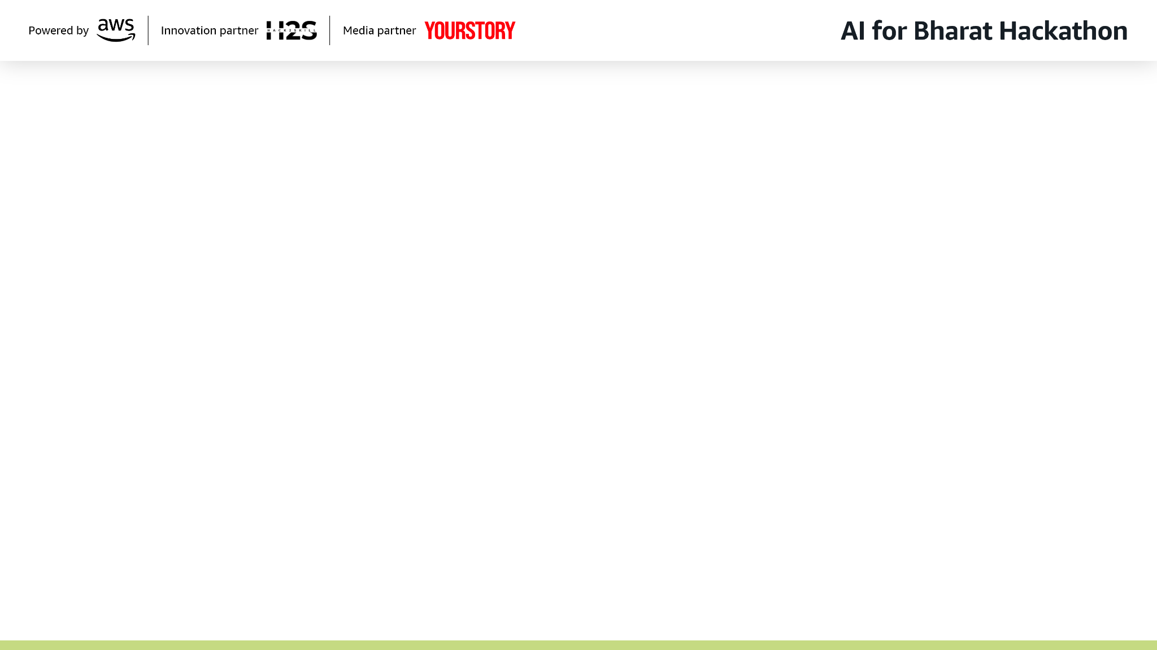
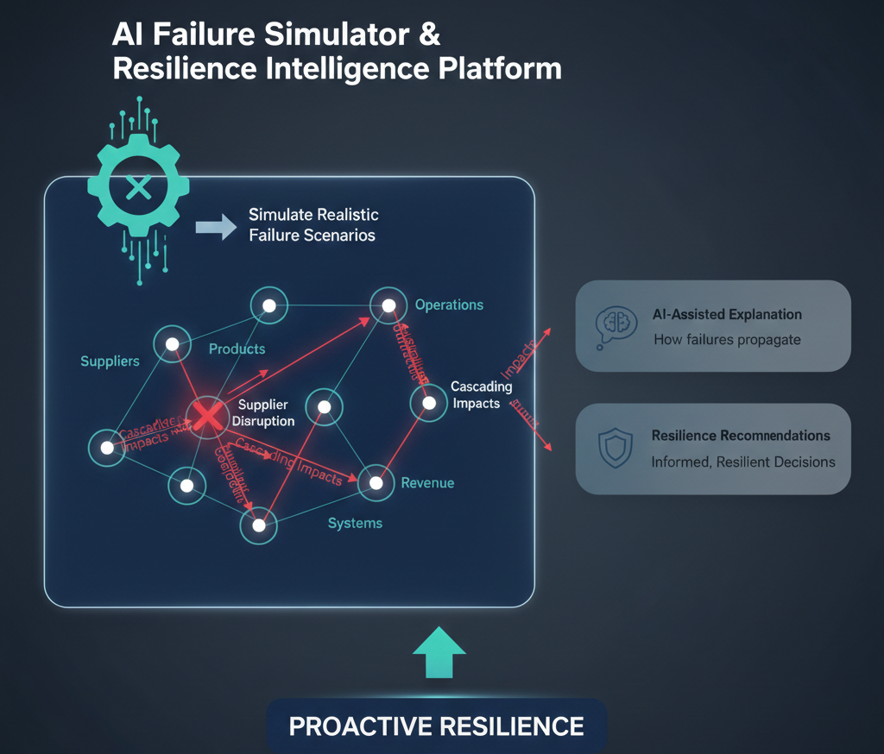
Brief about the Idea:
Modern enterprises are highly interconnected across suppliers, products, regions, and systems. While organizations invest heavily in analytics and forecasting, they largely remain reactive to failures such as supplier disruptions, demand shocks, and operational breakdowns. Current systems focus on reporting what has already failed rather than proactively understanding how failures propagate across the organization.
The AI Failure Simulator & Resilience Intelligence Platform addresses this gap by enabling pre‑mortem stress testing of enterprise decisions. The platform allows teams to simulate realistic failure scenarios before execution, analyze cascading impacts across operations and revenue, and receive AI‑assisted explanations and resilience recommendations. This helps leadership anticipate risks, understand failure propagation, and make informed, resilient decisions.

Slide 3
How is it different from existing ideas?
Existing solutions focus on forecasting success metrics or post‑incident analysis
Our solution focuses on failure‑first intelligence (pre‑mortem analysis)
Introduces Failure Propagation Analysis instead of isolated risk scoring
Uses AI for reasoning, explanation, and trade‑off analysis, not blind automation
Designed as an internal decision‑support system, not a generic chatbot or dashboard
How will it solve the problem?
Simulate failure scenarios (e.g., supplier disruption)
Quantify cascading impacts across products, regions, and revenue
Understand why the impact occurs through AI‑generated explanations
Compare mitigation strategies with clear cost vs risk trade‑offs
Make informed decisions before failures happen, not after
USP of the Proposed Solution
Pre‑Mortem Intelligence: Stress‑tests decisions before execution
Failure Propagation Score: Quantifies how far a failure spreads
Explainable AI Layer: Executive‑friendly reasoning, not black‑box ML
Enterprise‑Grade Design: Modular, configurable, responsible AI usage
Mobile Executive Briefing View: Risk insights in under 30 seconds

Slide 4
List of Features Offered by the Solution
Failure scenario configuration (supplier, demand, infrastructure)
Cascading impact simulation across dependencies
Failure Propagation Score (risk spread metric)
AI‑generated executive explanations
Resilience & mitigation recommendation engine
Web dashboard for analysts and ops teams
Mobile‑friendly executive risk summary view
Audit‑friendly and explainable decision logs

Slide 5
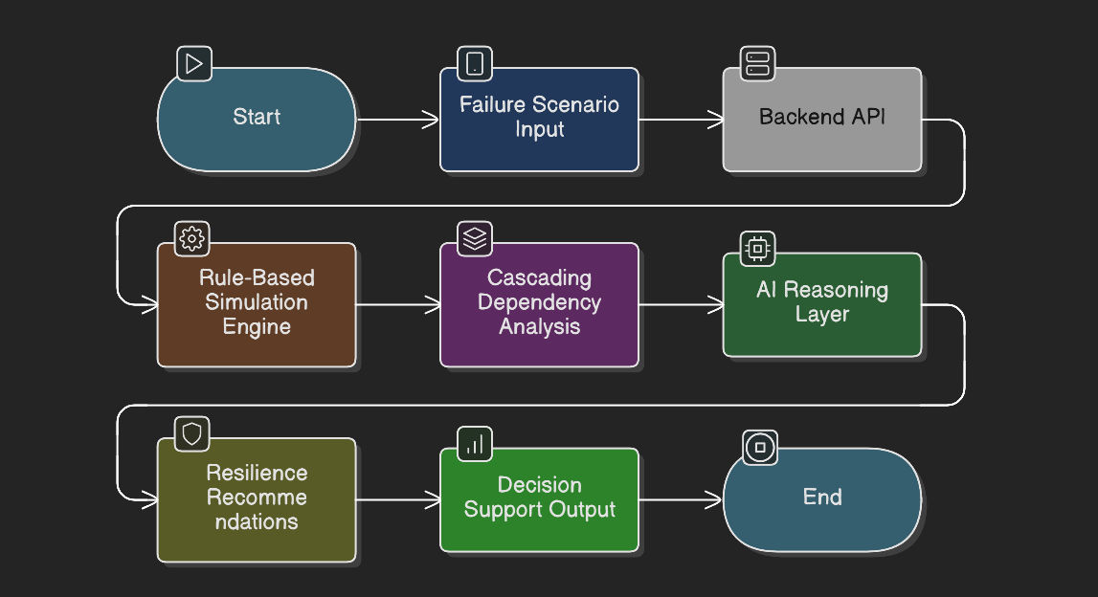
Process flow diagram or Use-case diagram
User defines a failure scenario (type, duration, severity)
Simulation engine evaluates dependencies and operational data
Cascading impact is calculated across products, regions, revenue
AI reasoning layer explains impact and highlights key risk drivers
Recommendation engine compares mitigation strategies
Insights are surfaced via web dashboard and mobile executive view

Slide 6
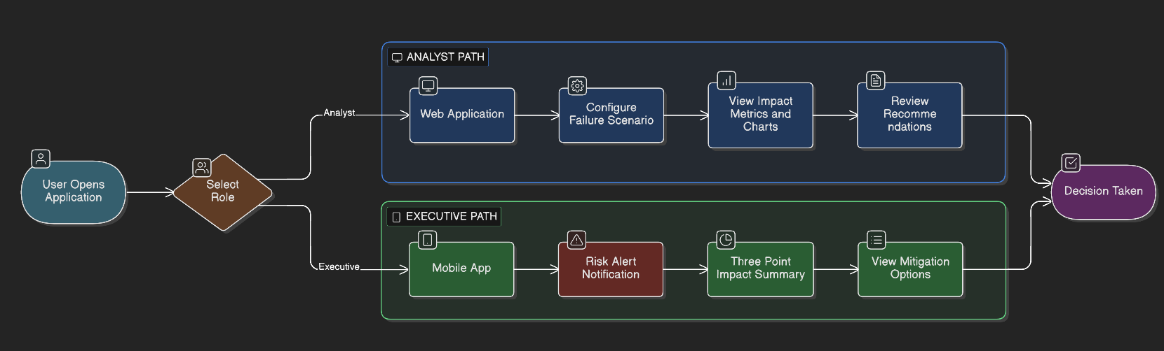
Wireframes/Mock diagrams of the proposed solution

Slide 7
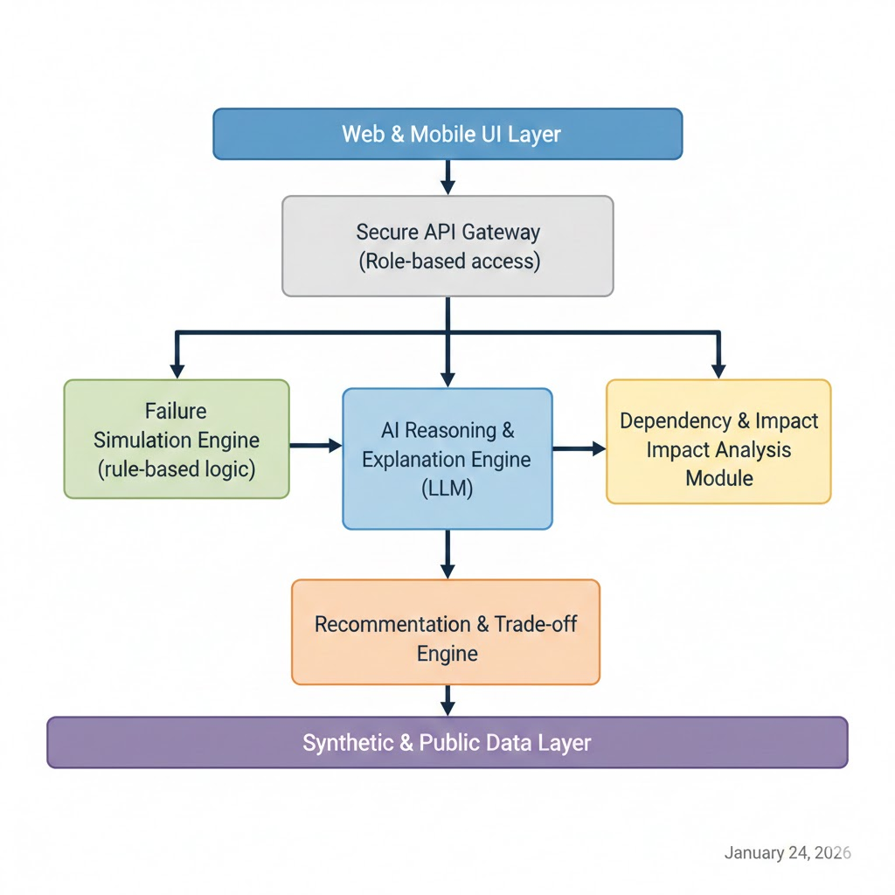
Architecture diagram of the proposed solution:
Web & Mobile UI Layer
Secure API Gateway (Role‑based access)
Failure Simulation Engine (rule‑based logic)
Dependency & Impact Analysis Module
AI Reasoning & Explanation Engine (LLM)
Recommendation & Trade‑off Engine
Synthetic & Public Data Layer

Slide 8
Technologies to be used in the solution:
Backend: Python / FastAPI
Frontend: Streamlit / React (responsive)
AI Layer: AWS Bedrock / OpenAI‑compatible LLMs
Data Processing: Pandas, NumPy
Visualization: Plotly / Chart libraries
Cloud: AWS (prototype‑friendly services)

Slide 9
Estimated implementation cost
Prototype / POC: Low cost using synthetic data and managed AI services
Scales incrementally based on enterprise usage and integrations
Designed for cost‑efficient experimentation before production rollout

Slide 10
Add as per the requirements for the hackathon:
Uses synthetic and publicly available data only
AI is used strictly for decision support and explanation
Human decision‑makers remain in control
Scope intentionally limited to demonstrate depth over breadth
Architecture supports future expansion across domains

Slide 11


